Slide 1

Driving Factors of Movie Success
Arnav Jain, Hasan Muhammad, Pratik Bhat, Vivian Zhang

Slide 2

Background + Dataset

Slide 3
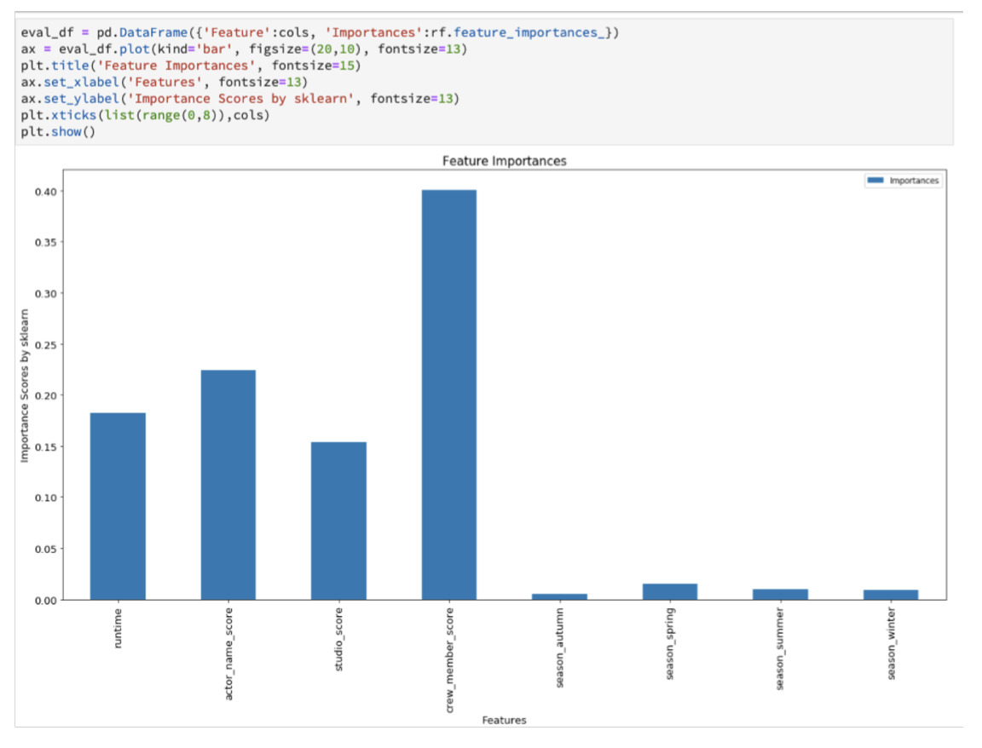
Background
Analysis and Prediction of a Film's Success using Data Mining Techniques - Nima Zahadat and Kartikay Avijeet
Predicts which factors are most important in determining if a movie would be successful
Director
Actors
Release Date
Genre
Language
Viewer Rating
Conclusion: behind the scene score, actor score, studio score are the most important

Slide 4



Hypothesis test

Slide 5

Hypothesis Testing
Confidence intervals
Visual Analysis
Confidence Intervals
Threshold: average of [factor]
A/B groups: movies above vs below the threshold
Test stat: distance between average popularity for movies above and below the threshold
Null: test stat = 0
Alt: test stat does not = 0
Visual Analysis

Slide 6

Data Visualization

Slide 7
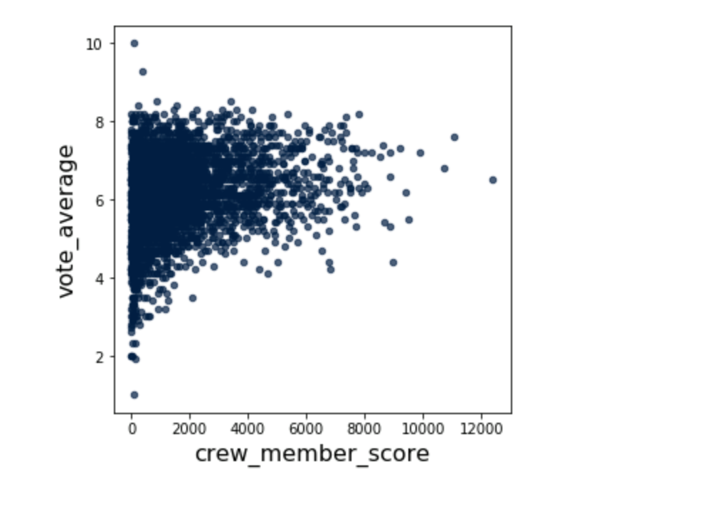
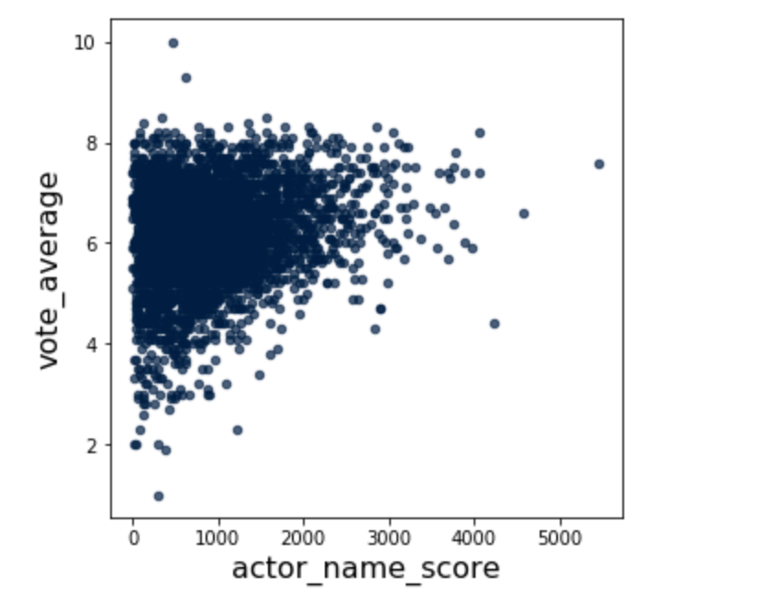
T-Test
t-stat = 0.342534
Confidence interval: [-0.057318, 0.056744]
Because the t-stat was outside the confidence interval, it was statistically significant
t-stat = 0.317214
Confidence interval: [-0.060538, 0.058431]
Because the t-stat was outside the confidence interval, it was statistically significant
Notes:
Put the pictures from the visualization and talk about what each one is

Slide 8
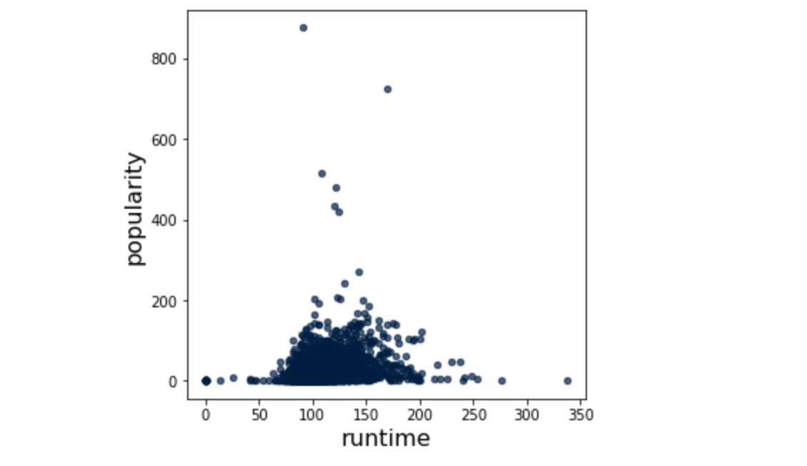
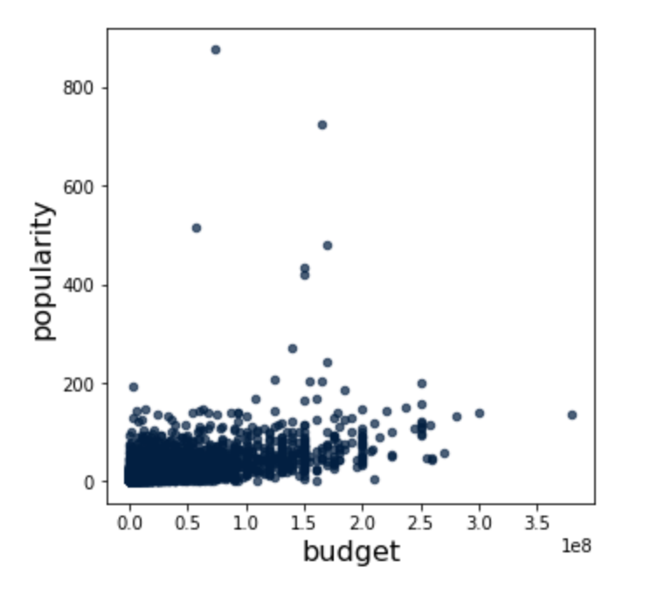
Outside Variables
Correlation Coefficient: 0.23324122282495613
Very small correlation
Correlation Coefficient: 0.5000357985863506
Medium correlation

Slide 9

Process + Conclusions

Slide 10
Process
T-Test
We conducted the t-test on the two most important variables the original study found as relevant predictors of movie success
For our t-test, we took the scores and computed the average value.
The null hypothesis was the distance between the average movie rating between high and low crew scores was 0.
Outside Variables
Created a scatter plot looking at runtime and budget vs popularity
We then added a line of best fit and computed the correlation coefficient of each factor
What didn’t work: Trying to replicate their process completely, end-to-end. We tried to replicate every piece of code and quickly realized this wasn’t possible. It wasn’t efficient and it was too difficult to replicate certain steps
What did work: Creating scatter plots using their original table → crafting our own method for analysis. We also wanted to use a t-test, which they didn’t use as their test-statistic.
Notes:
What didn’t work: originally, we tried to replicate their process completely → end to end we tried to re-analyze the code and we quickly realized this wasn’t possible. This was efficient and it was too difficult to replicate certain steps.
What worked: creating scatter plots using the original table → crafting our own method for analysis. We also wanted to use a t-test, which they didn’t use as their test-statistic to check the variables that they did test.

Slide 11
Conclusions
T-Test
Since the observed statistic was found to be outside of the confidence interval, this implies that it was statistically significant, and hence we can reject our null hypothesis in favor of the alternative. This shows that the variables the original study found to be important, are statistically significant in determining movie success.
Outside Variables
The small correlation value for runtime supports the idea that this variable was appropriately left out in the original study. The correlation value obtained for budget and popularity indicates a moderate correlation and so perhaps the variable could have been included in the final output of the original study.

